Slide 1
PROBLEM STATEMENT and TEAM
→ Hospitals need to manage patient flow efficiently, maintain medical records, schedule appointments, and handle emergency cases while ensuring data integrity and quick access to critical information.
→ MEMBER 1 : Dhanush V Biradar (SRN : PES2UG24CS155)
→ MEMBER 2 : GAUTAM KRISHNA (SRN : PES2UG24CS169)
→ MEMBER 3 : HARKIRAT SINGH (SRN : PES2UG24CS180)

Slide 2

Data Structures for Modern Hospital Management
In today's fast-paced healthcare environment, efficient data management is paramount. This presentation explores how fundamental data structures like Binary Search Trees (BSTs) and Linked Lists can be effectively applied to streamline hospital operations, ensuring optimal patient care and administrative efficiency.
Data Structures Used and Why
Binary Search Tree (BST)
Linked List
Ideal for managing dynamic patient records, BSTs facilitate rapid insertion, searching, and deletion of patient data. Their ordered structure allows for quick retrieval of specific records, finding patients by ID, and efficient traversal, crucial for patient flow management and administrative tasks.
Linked lists are perfectly suited for scheduling and managing patient appointments. Each node can represent an appointment, containing a patient's ID and scheduled time. This dynamic structure allows for flexible addition and removal of appointments, adapting seamlessly to changes in schedules, such as when patients are admitted or discharged.
Fast access to patient data
Efficient patient flow management
Dynamic appointment management
Ordered record keeping
Flexible scheduling adjustments
Efficient addition/removal of appointments

Slide 3


ADT Definition & Essential Operations
Understanding the Abstract Data Type (ADT) definitions for BSTs and Linked Lists clarifies their functional roles within the hospital management system. Each structure supports a specific set of operations designed for efficiency and data integrity.
1
2
BST Operations: Patient Records
Linked List Operations: Appointments
createNode: Initializes a new patient record node.
scheduleAppointment: Inserts a new appointment for a patient.
insertNode: Adds a new patient into the BST.
printAppointments: Displays all scheduled appointments.
searchNode: Locates a patient record by ID.
removeAppointmentsByPatient: Deletes all appointments linked to a specific patient upon their removal.
findMin/findMax: Identifies patients for emergency cases or retrieves the latest registered patient.
freeAppointments: Deallocates memory used by appointment nodes.
deleteNode: Removes a patient and associated data.
inorder/preorder/postorderTraversal: Displays patient details in various orders for reporting.
freeTree: Manages memory by releasing all patient records from the tree.
All operations utilize dynamic memory allocation and pointer manipulation to ensure optimal performance, scalability, and data integrity across the entire system.

Slide 4
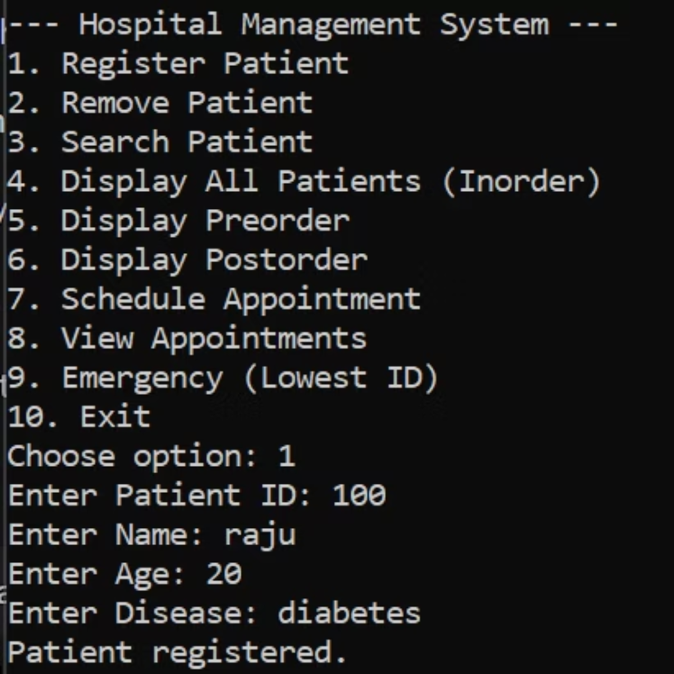
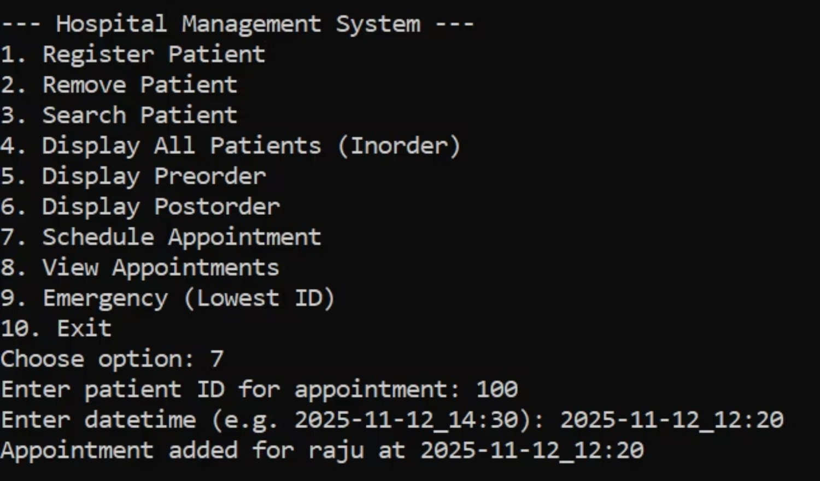
Input and Output Screenshots: Functionality in Action
Witness the practical application of these data structures through screenshots demonstrating key functionalities within the hospital management system. These visuals illustrate how patient and appointment data are managed, from registration to complex retrieval operations.
Patient Registration
A sample screenshot showcasing the interface for entering new patient details, followed by a confirmation output. This demonstrates the successful insertion of a new node into the BST.
Appointment Scheduling
This screenshot captures the input prompts for scheduling a new appointment, along with the system's confirmation message, illustrating the dynamic addition of nodes to the linked list.
All displayed screenshots are captured directly from the terminal running the implemented code, validating the functionality of each described scenario.

Slide 5
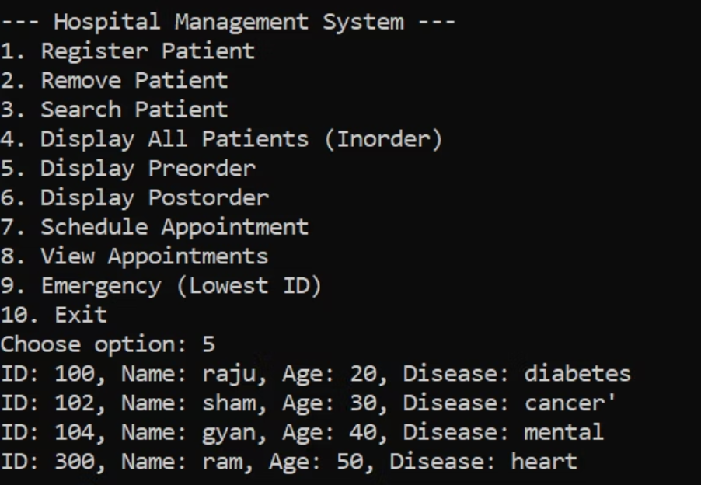
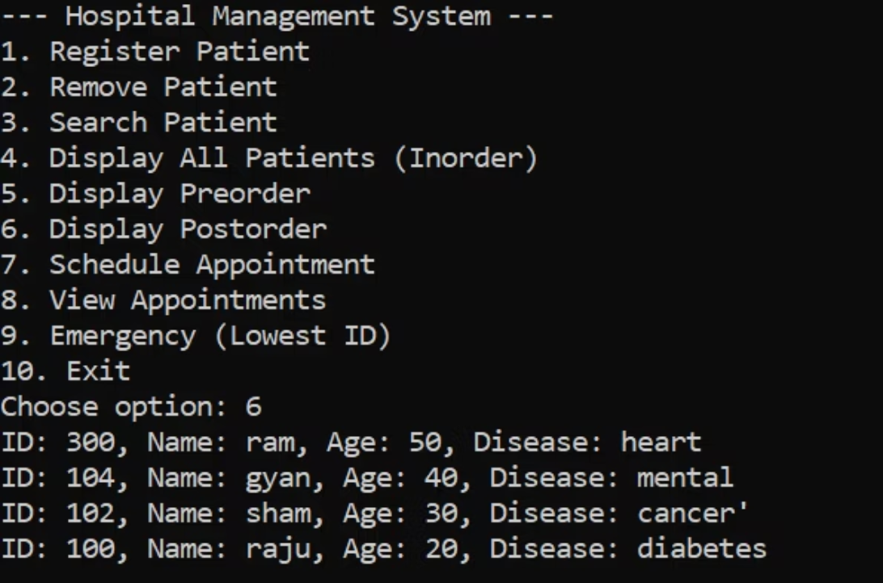
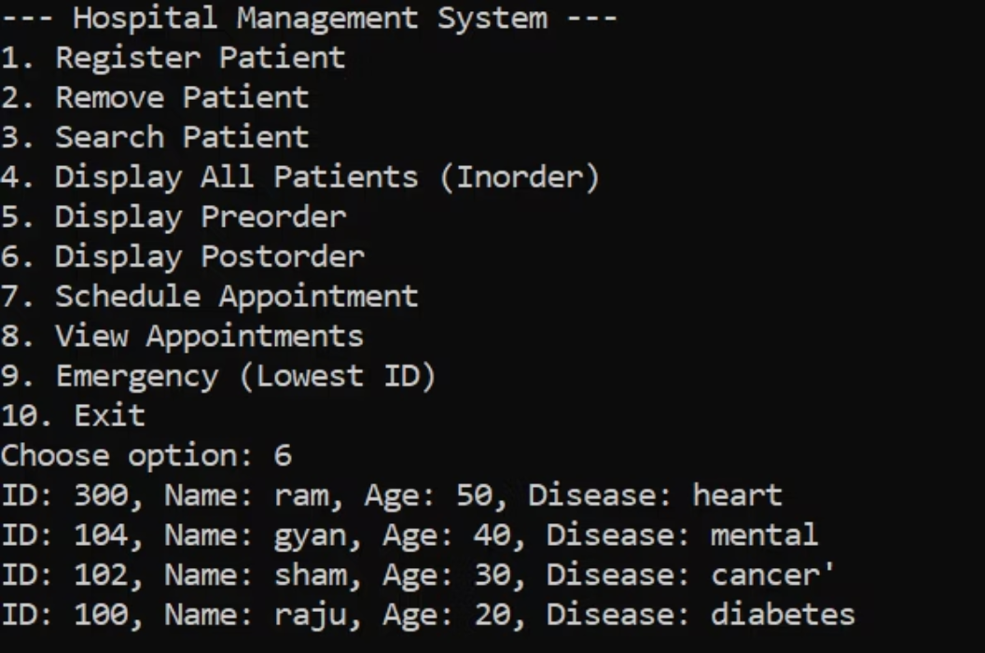
Input and Output Screenshots: Part 2
Continuing our visual tour, these screenshots further highlight the robust capabilities of our hospital management system, demonstrating advanced functionalities.
Traversal Operations
Screenshots demonstrating how the system performs various traversal operations, such as an in-order display of all patient records from the BST or iterating through the linked list of appointments to list all upcoming schedules.
These visuals underscore the versatility and reliability of data structures in delivering a comprehensive hospital management solution.

Slide 6
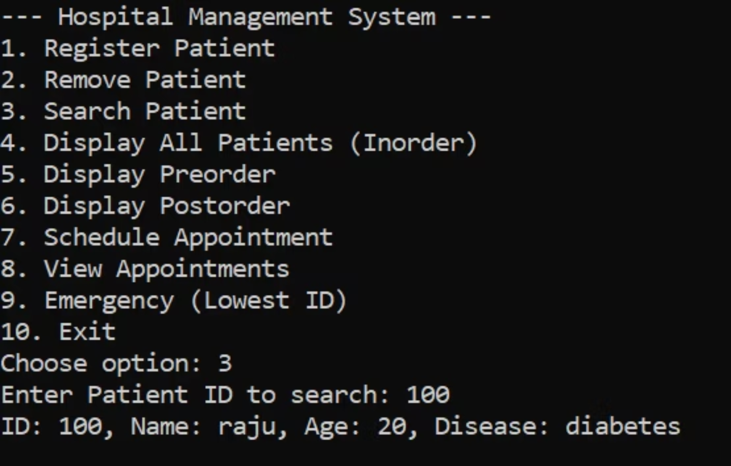
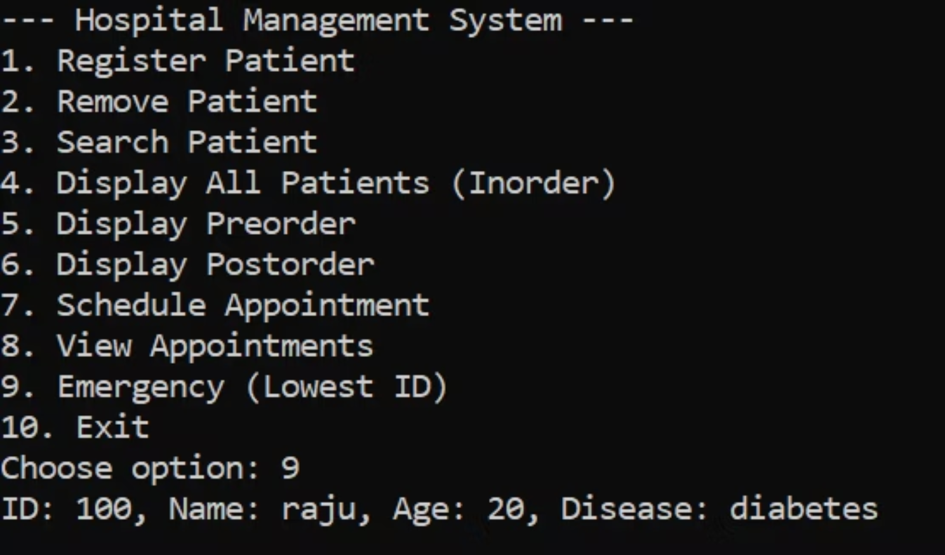
Input and Output Screenshots: Search & Emergency
Search and Emergency
Screenshots highlighting the system's ability to quickly search for specific patient data or identify critical information in emergency scenarios, showcasing the efficiency of the underlying data structures.

Slide 7
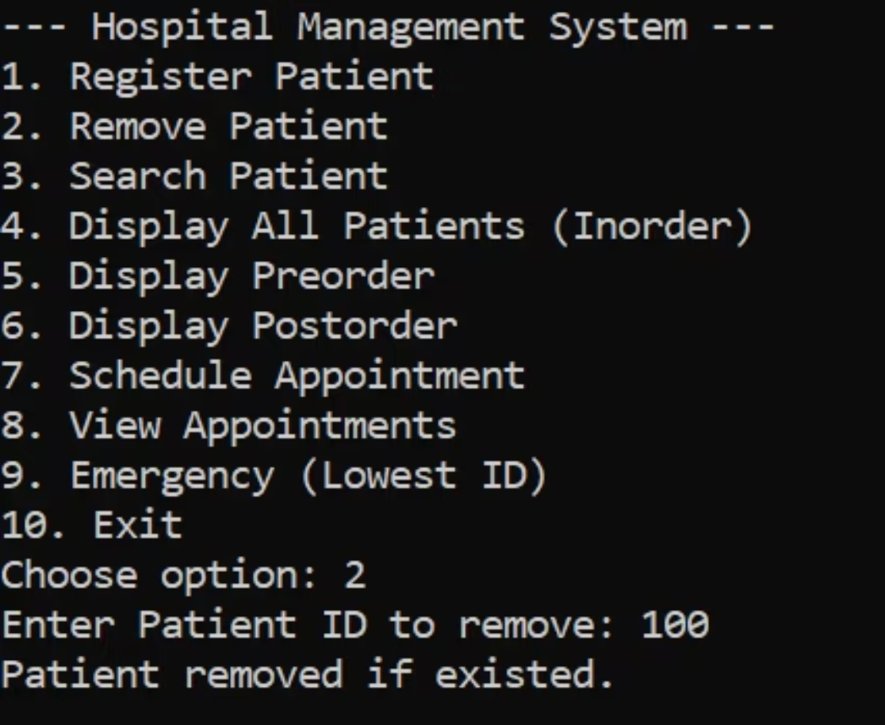
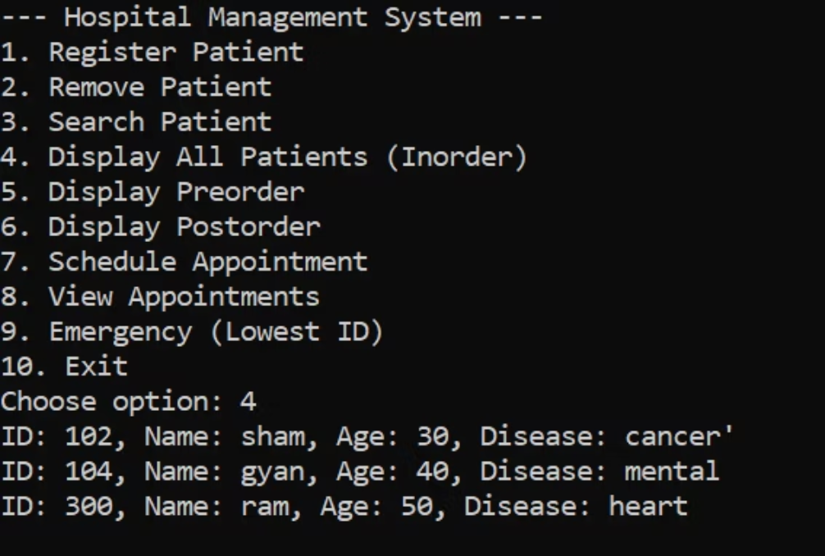
Input and Output Screenshots: Part 3
Display All Patients
Visuals demonstrating how the system efficiently displays all patient records stored in the BST, typically in a sorted order.
Remove Patients
Screenshots illustrating the process of removing patient records from the BST, including confirmation messages and updated displays of remaining records.

Slide 8

Conclusion & Team Division
Conclusion: A Robust Management System
Work Division: Collaborative Success
This project successfully leverages the power of Binary Search Trees (BSTs) and Linked Lists to create a robust and efficient hospital management system. By strategically applying these data structures, we have established a foundation that ensures seamless patient flow, accurate record manipulation, and effective emergency handling.
BST Implementation:DHANUSH
The system demonstrates strong data integrity, rapid response times for critical operations, and a user-friendly interface for managing complex healthcare data. Its design supports all key patient-related processes, from registration to appointment scheduling and record retrieval, proving the efficacy of classic data structures in modern applications.
1
Developed the core BST logic, including node creation, insertion, deletion, and traversal functions. Responsible for patient record management and search functionalities.
Linked List for Appointments
2
:GAUTAM
Implemented the linked list for appointment scheduling, ensuring dynamic addition, removal, and printing of appointments, with a focus on integration with patient records.
User Interface & Integration: HARKIRAT
3
Designed the terminal-based user interface and ensured seamless integration between the BST and Linked List modules. Managed input/output handling and overall system flow.
Testing & Documentation
4
: DHANUSH,GAUTAM,HARKIRAT
Conducted comprehensive testing of all functionalities, identified and resolved bugs, and prepared detailed documentation for the system's architecture and usage.

